Slide 1

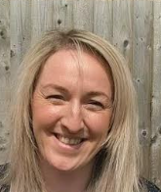
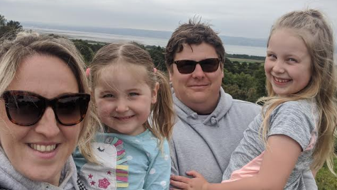
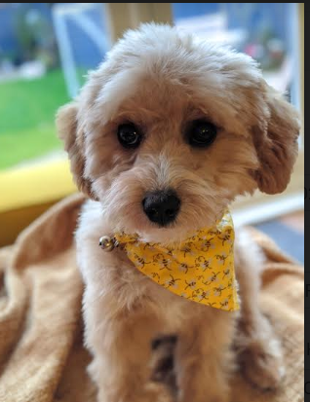

I’m Mrs Walker
Hello everyone!
I am so excited to be your new teacher in Foundation 2 from September. It’s going to be a year full of fun, learning and lots of adventures. I thought that you would like to know a little more about me before we start our time together…
I also have a Poochon called Mavis. She is 3 years s old now and we love her so much!
I have two wonderful children, Ava 10 and Ivy 7 and a fantastic husband!
I can’t wait to teach you all in September!
Purple
Spring
Pasta
A nice cup of tea!
Anything from the movie Coco
The Everywhere bear
Swimming

