Slide 1
Science
Forces
Year One
Science | Year 5 | Forces | Friction | Lesson 5

Slide 3
Aim
To investigate the effects of friction.
Success Criteria
I can explain the effects of friction on a moving vehicle.
I can investigate the effects of friction created by different materials.
I can recognise and control variables in an investigation.

Slide 4
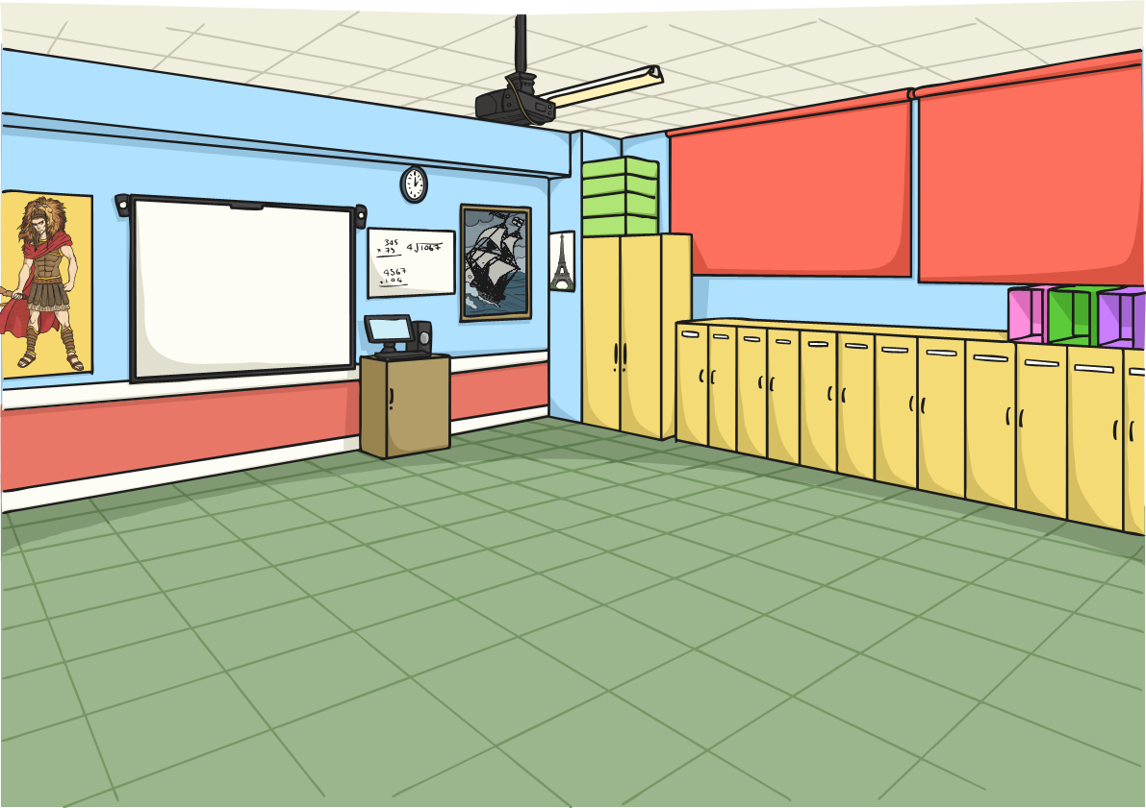
What Is Friction?
Look at the statements about friction. Can you decide which are true or false? Discuss your ideas with your partner before sharing your thoughts with the class.
Friction is always a useful force.
Friction is a force.
Friction is always a useful force.
Friction is a force.
All surfaces create friction on an object moving over them.
All surfaces create friction on an object moving over them.
Friction slows moving objects down.
Friction slows moving objects down.
Friction produces heat.
Friction is stronger than gravity.
Friction produces heat.
Friction is stronger than gravity.
How did you do?

Slide 5
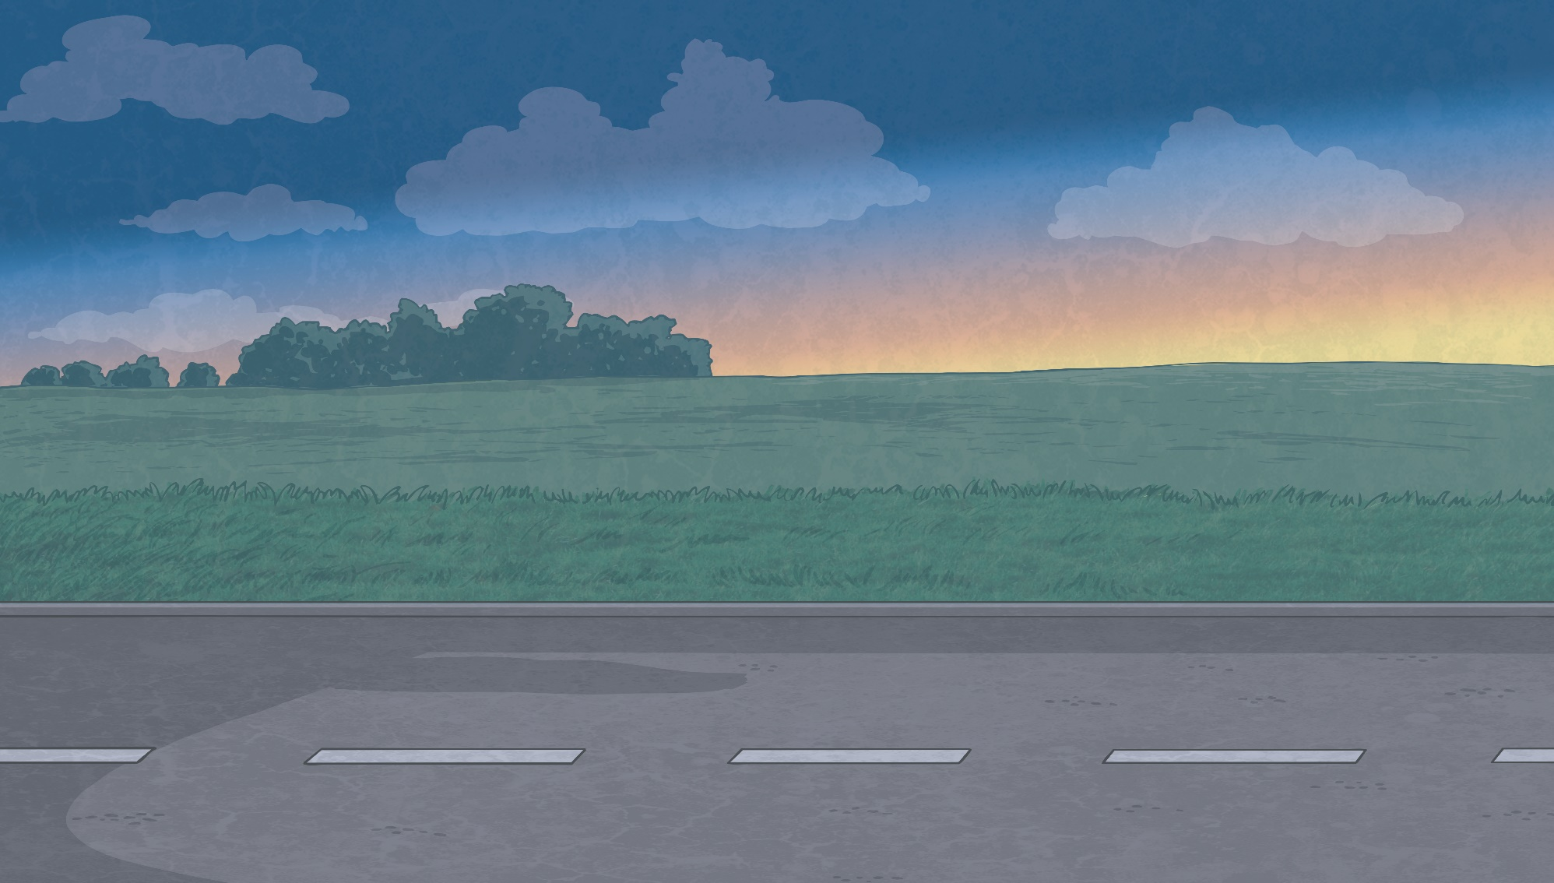
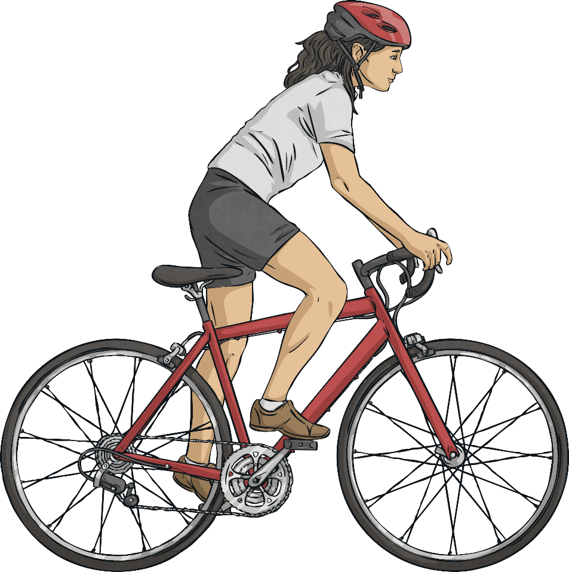
What Is Friction?
Can you explain to your partner how friction affects a moving object?
All surfaces create friction on an object moving across them. Rougher surfaces produce more friction, but even very smooth surfaces like ice produce some friction.
Friction is a force that acts between two surfaces or objects that are moving, or trying to move, across each other. For example, when you try to push a book across the floor, friction makes this difficult.
Friction always acts in the opposite direction to the direction that the object is moving. It always slows a moving object down.

Slide 6
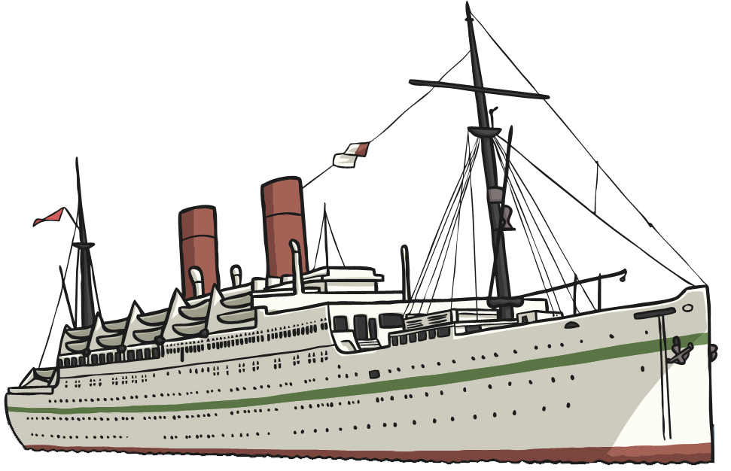
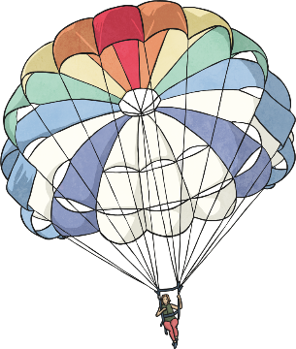
What Is Friction?
Friction can be useful – for example, the soles of your shoes create friction with the ground, preventing you from slipping over.
Air resistance and water resistance are both forms of friction. Gases and liquids create friction as well as solids.
However, friction can be unhelpful too – friction on a bike chain can make the bike harder to pedal.

Slide 7
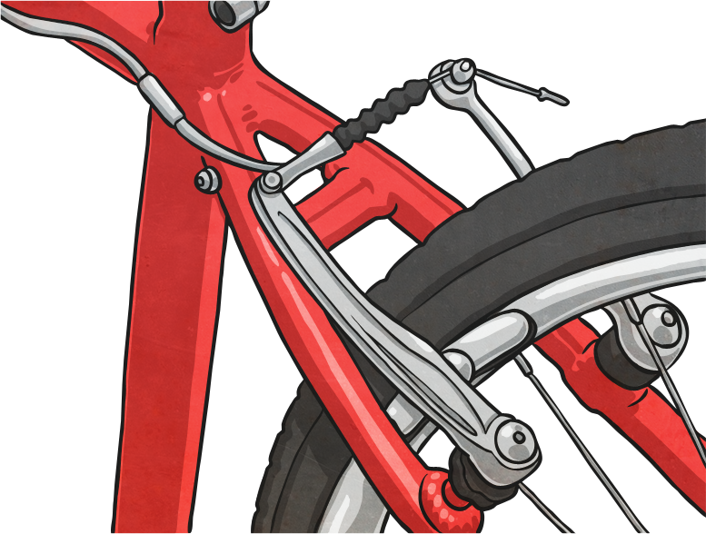
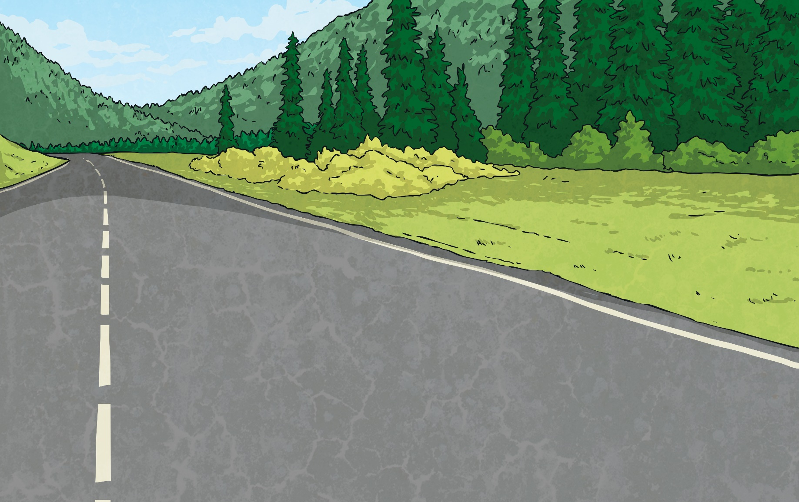
Friction in Action
Friction is created here between the brake pad and the wheel.
The brakes on a bicycle or car work by creating friction between the brake pad and the wheels.
The friction opposes the movement of the wheels, slowing them down and eventually stopping them.

Slide 8
Design a Brake Pad
A company that makes tricycles and scooters wants to create a new set of brakes for their latest model. They need to make sure their tricycles and scooters slow down and stop safely for the young children using them.
They have asked you to help them find the best material for their brake pads. The best material will be the one that creates the most friction between the brake pad and the wheel.
You will need to test different materials and demonstrate the best choice.

Slide 9
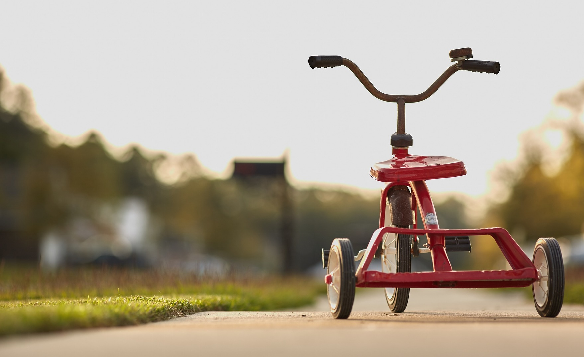
Design a Brake Pad
To test the different materials for the brake pad, you will need a small tricycle or scooter, a piece of thick card (about the size of a playing card), different materials to wrap around the card and a stopwatch.
Work in groups. Spin the wheel of the tricycle or scooter, then carefully hold the piece of card with one material wrapped around it against the spinning wheel. Be careful not to put your fingers on the wheel. Use the stopwatch to time how long it takes for the wheel to stop completely.
Then wrap the card in a different material, and time how long that material takes to stop the wheel.
Complete this with each different material.

Slide 10
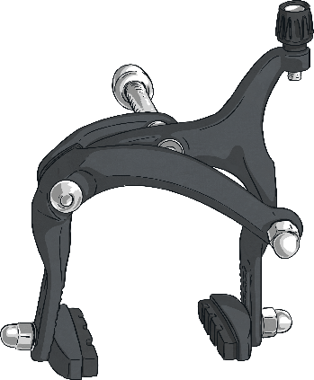
Reliable Results
When scientists carry out investigations, it is important that they control all the variables to get reliable results.
The variable to be measured is the time it takes for the wheel to stop spinning.
All the other variables in the investigation will need to be kept exactly the same each time.
Can you think of any variables in this investigation that may be tricky to keep the same every time?
In this investigation, the variable that is being tested is the type of material the brake pad is made from. This will be changed each time.

Slide 11
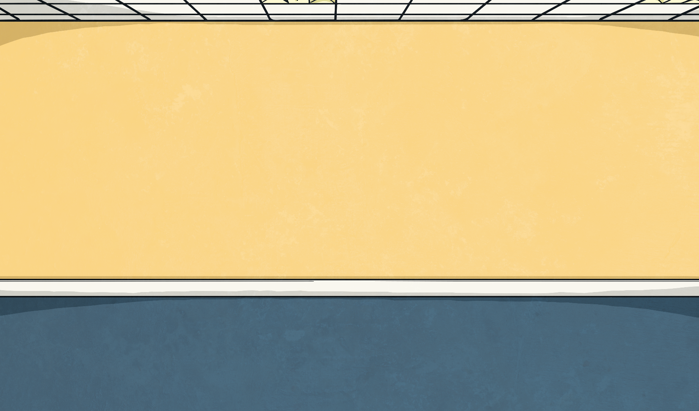
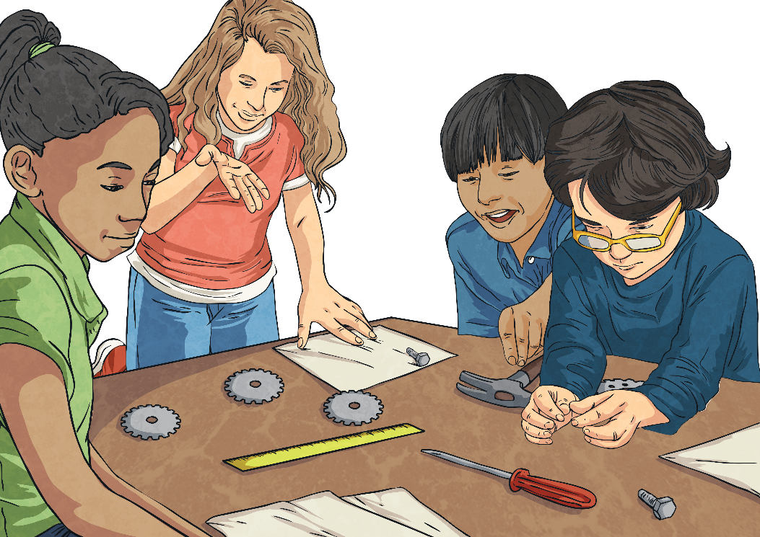
Reliable Results
You will need to be very careful to control these two variables.
In your group, discuss how you could try to keep these variables the same.
If you press the brake pad onto the wheel very hard with one material, but gently with another, your results will not be reliable.
If the wheel spins very quickly when you try one material, but slowly when you try another, you will not get reliable results.
There are two variables that could be tricky to keep the same: the speed at which the wheel spins each time, and the pressure with which the brake pad is applied to the wheel.

Slide 12
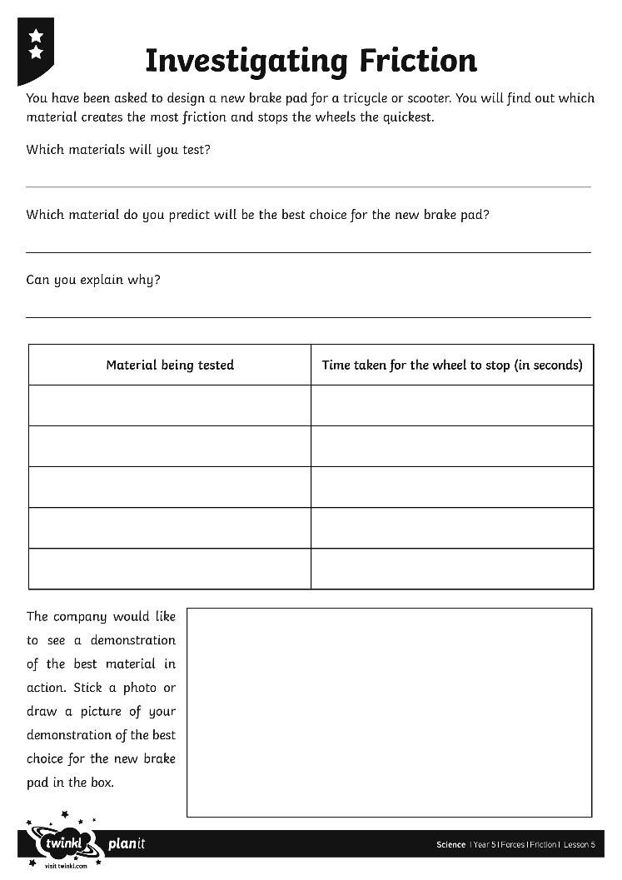
Find the Best Brake Pad
Now that you have tested the different materials, you should know which material is the best choice for the new brake pad. The company want to see a demonstration of the best material in action.
Use your Investigating Friction Activity Sheet to write an explanation of your choice, and then take turns to demonstrate to the class how the best brake pad material works.
Look at the different materials that you will test.
Predict which one will create the most friction and be the best choice for the new brake pad. Explain your choice on your Investigating Friction Activity Sheet.
Then it is time to carry out your investigation! Complete the table on your activity sheet to show how long each material took to stop the wheel.
What did you learn by completing this investigation?

Slide 13
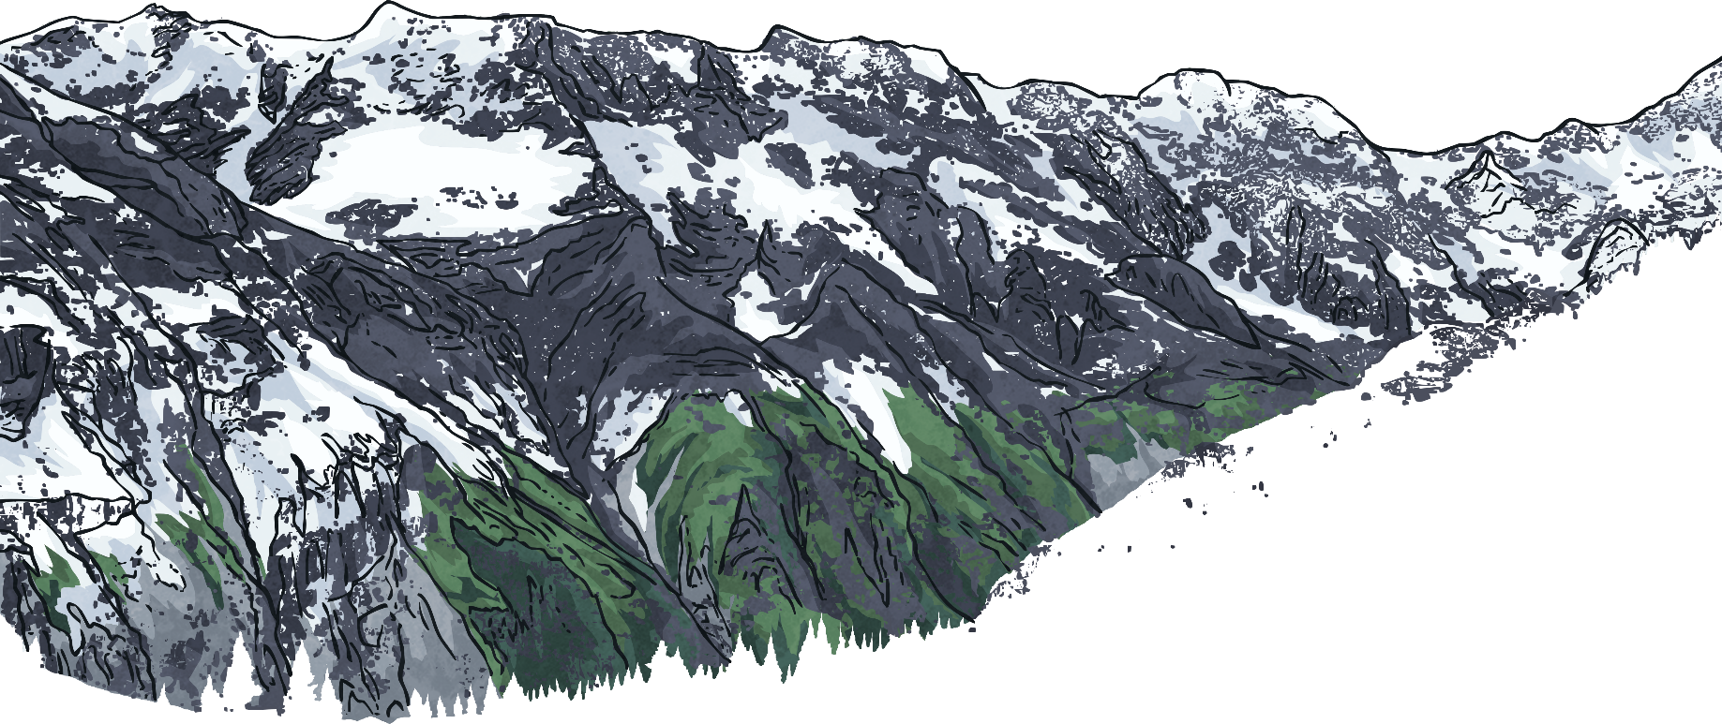
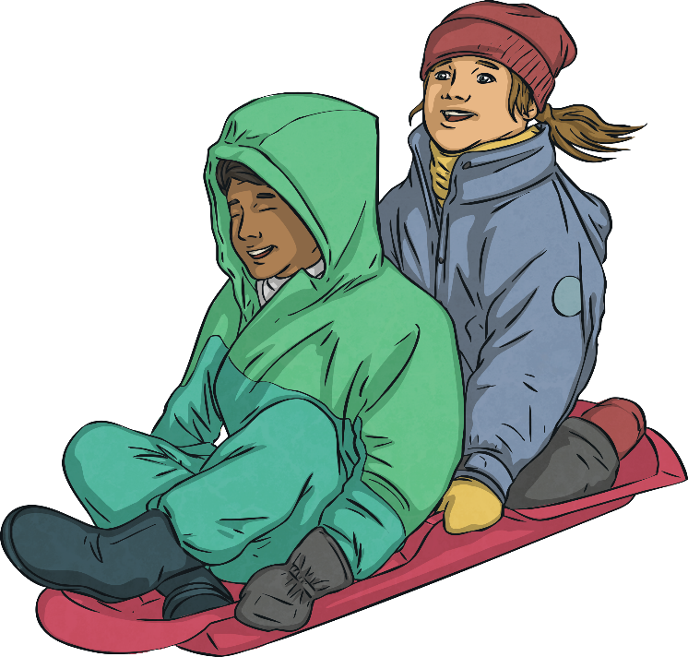
Solve and Explain
Discuss with your partner:
How would you change the design of the sledge to solve this problem?
What would you say to the children to explain how you managed to slow down their sledge? As they are younger children, you must talk about friction in a simple way so that they will understand.
Your younger friends love sledging, but they wish the sledge would not go quite so quickly down snowy hills.

Slide 14
Solve and Explain
What would you do?
I would use a strong glue to attach a carpet to the bottom of the sledge.
I would tell the children that friction is a force that acts between the snow and the bottom of the sledge as they move across each other. I would explain that the sledge glides quickly over the snow because the smooth plastic bottom of the sledge does not cause very much friction. However, the rough carpet causes more friction with the snow, so the sledge would move more slowly with carpet glued to the bottom.

Slide 15
Aim
To investigate the effects of friction.
Success Criteria
I can explain the effects of friction on a moving vehicle.
I can investigate the effects of friction created by different materials.
I can recognise and control variables in an investigation.

